Slide 1

Portfolio Presenation
By K.Chandan Puthuraya

Slide 2
What is react? Why is it used and what are its features?
React provides state-of-the-art functionality and is an excellent choice for developers looking for an easy-to-use and highly productive JavaScript framework.
Using React, you can build complex UI interactions that communicate with the server in record time with JavaScript-driven pages.
Its main and basic feature is code reusability which helps us to create the different components that we have to use while web development and we can also reuse the components.
These are the key basic features the helps us to organize the components and makes the ui/ux look neat and responsive.

Slide 3
The different Hook’s used are:
useState
Here in this function at first the default value of the state is set as false . Then after that we have to initialize the ternary condition . Then when the ternary condition becomes true then , the truth statement is implemented . Else the false statement is implemented . This is mainly used for the hamburger icon to show itself only when the view is set to the mobile view.

Slide 4
useEffect
The useEffect hook is part of the Hooks API in React, and it allows you to perform side effects in your functional components. Side effects may include data fetching, subscriptions, manually changing the DOM, or other operations that affect the outside world. Here in our portfolio it is used to fetch the location’s data or to say in proper manner , it allows to fetch the current location that the user has clicked and the through this we can create functions where in we can hide the current component name of the navbar and display the other components and so on.

Slide 5
useLocation
In React, the useLocation hook is commonly associated with the React Router library, specifically with the react-router-dom package. This hook provides access to the current location object in a React component. This is basically used to notify us that in which location we are and gives us the access to that location so as to use it for our purpose . In this portfolio we use this hook as to access that location and then we create a function to fetch so that the accessed location component name should be hidden when it is clicked and then other components should be displayed in the navbar.

Slide 6
useRef
The useRef hook in React provides a way to create mutable object references that persist across renders. It is often used to access or store references to DOM elements, store mutable values, or persist values between renders without causing re-renders. Here this hook is used in one of our contact us form where in there is a function set that when you onclick the submit button in the form it goes to the useRef hook that has been used with the keyword “ref” and then it stores the data that had been entered in that form.

Slide 7
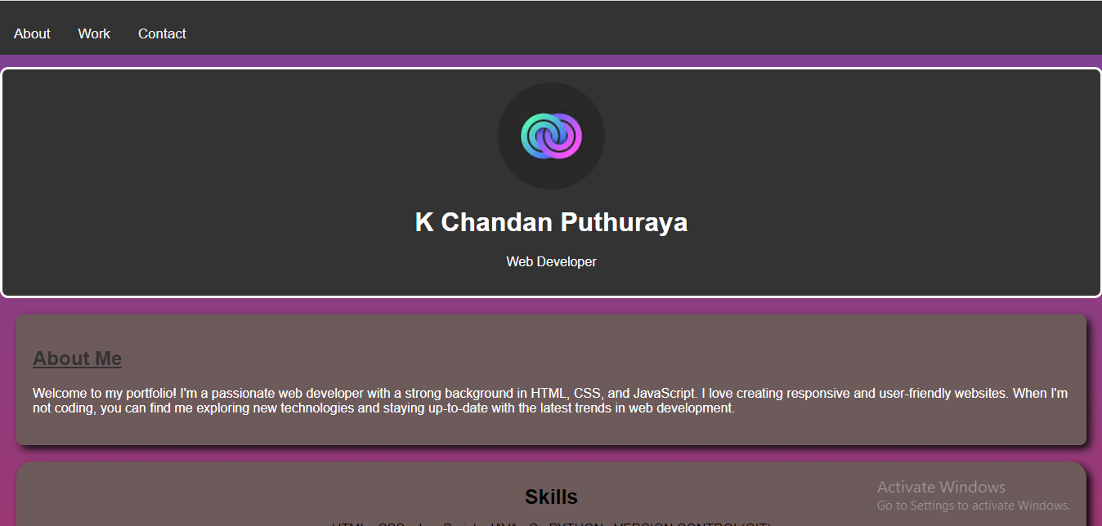
Let us see the overview of the Portfolio :
Home section (Desktop view):

Slide 8
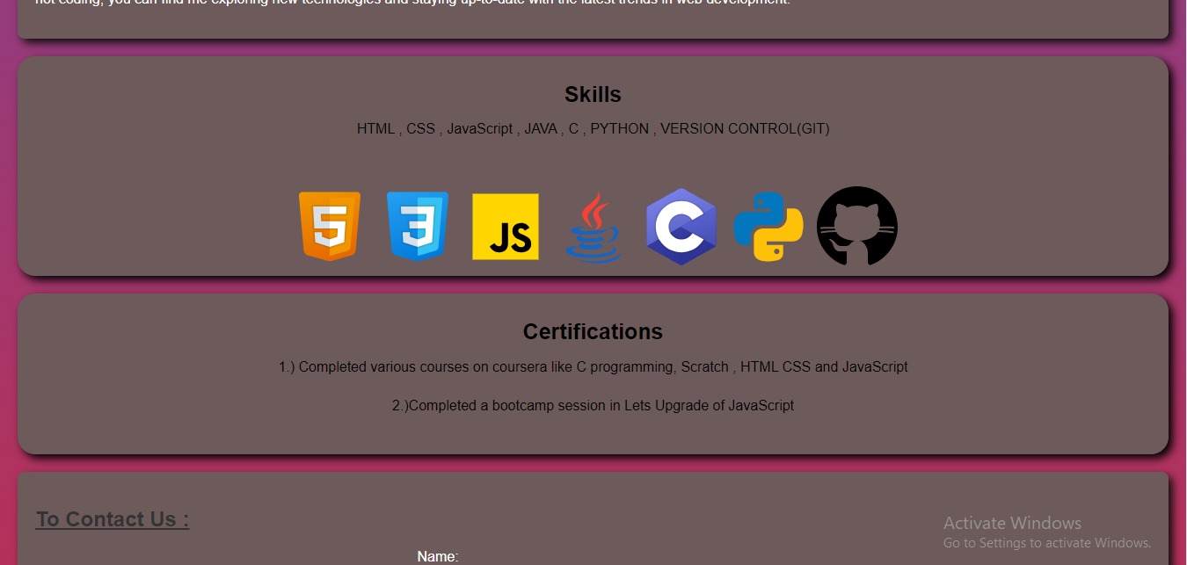

Slide 9
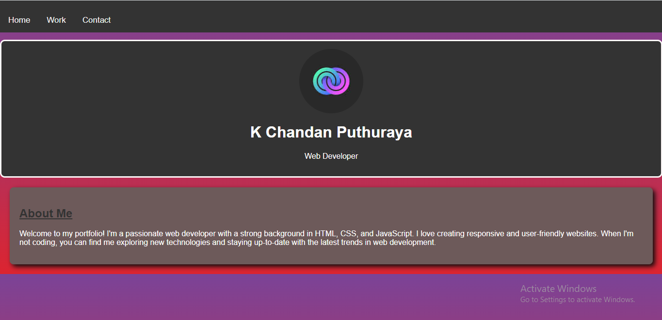
About section(desktop view) :

Slide 10
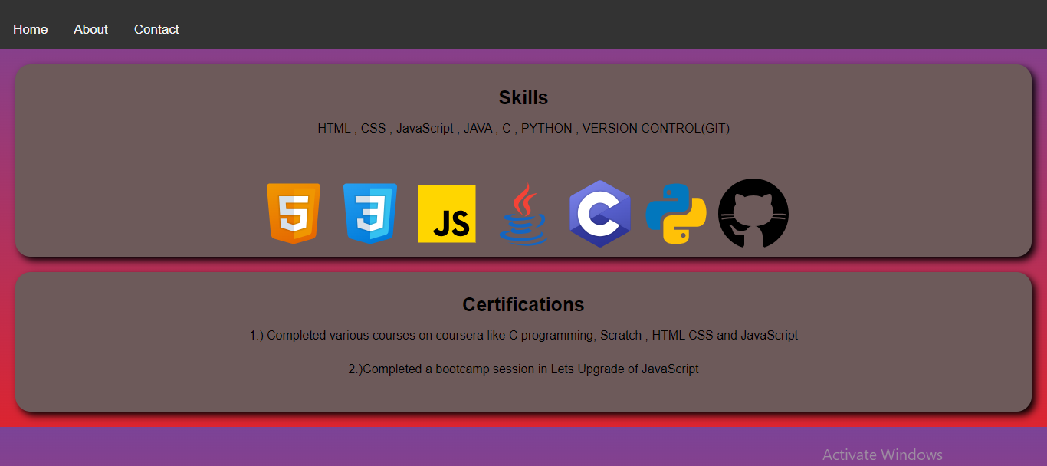
Work section(desktop view) :

Slide 11
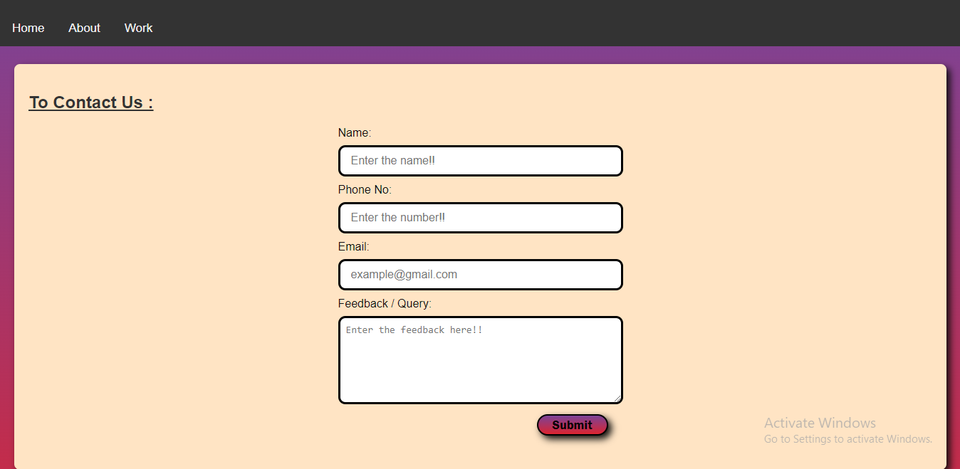
Contact section(desktop view) :

Slide 12
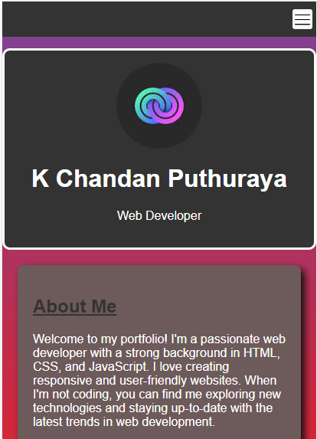
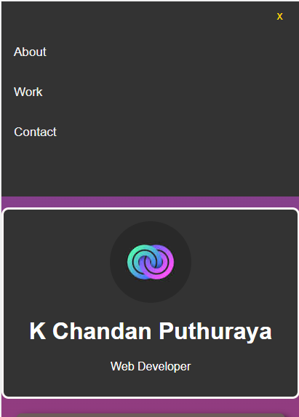
Navbar section(mobile view) :

Slide 13
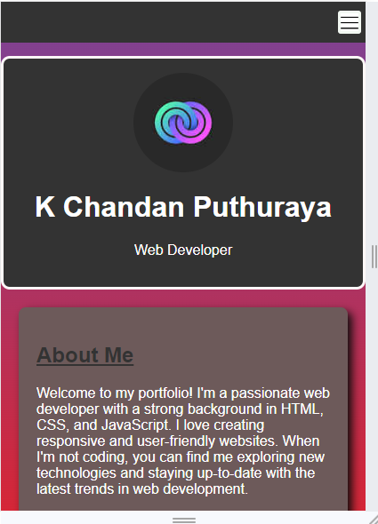
About section(mobile view) :

Slide 14
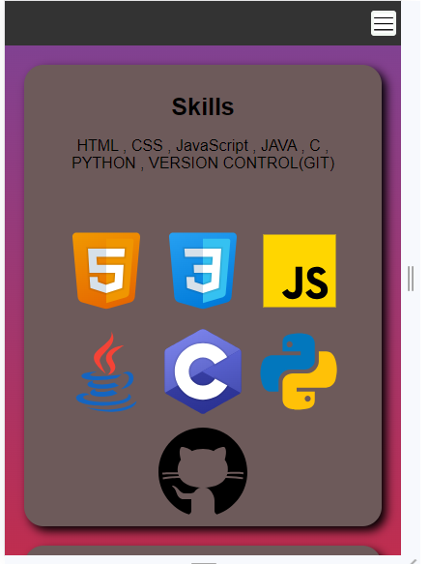
Work section(mobile view) :

Slide 15
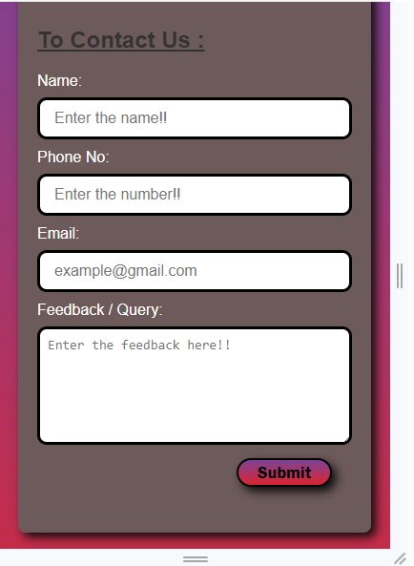
Contact section(mobile view) :

Slide 16
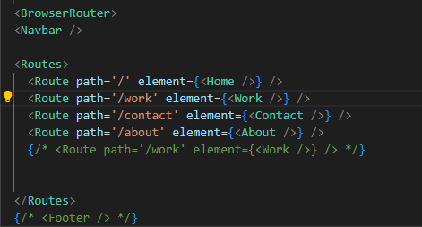
The use of Routing :

Slide 17
The use of Routing :
Here at first the routing concept is used in the navbar so that the routes or the pathname of the different components in the navbar is given to the app.js file so that when you click on the different components the page also should redirect to that component . This is how routing is done.

Slide 18
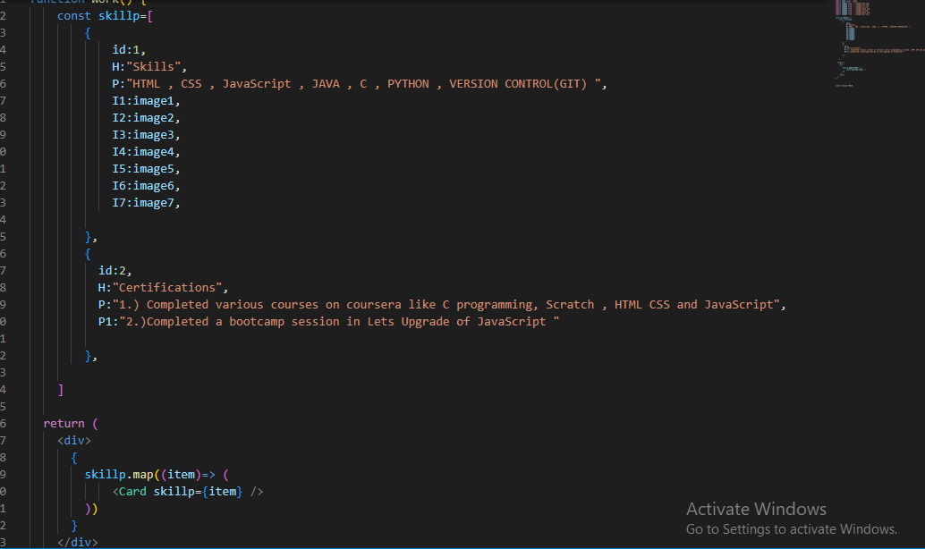
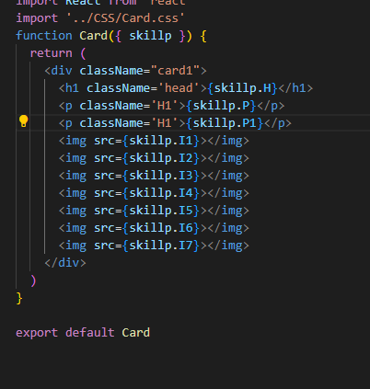
The use of Props :

Slide 19
The use of Props :
Here the use of props is done in the skills section . So the concept is to make a card file which is the common container or box and create a css file and apply to it. Then we create separate skills file and give an array for the contents to be filled in the container with id for each. Then the card file fetches the array items with given prop name and array id and displays it in the desktop and mobile.

Slide 20
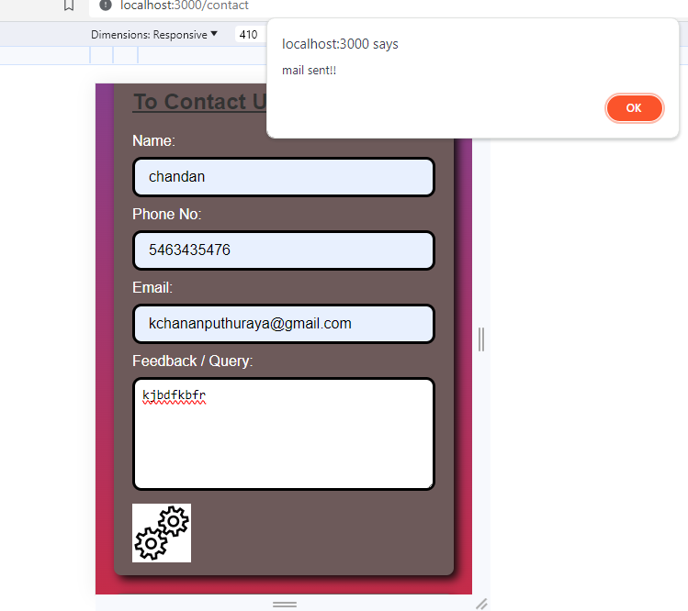
Email JS and adding Buffer:

Slide 21
Here an external gif is applied and then it is imported to the file . Then through the function sendemail , when the submit button is clicked the setloading becomes true and the buffer icon then appears and then the alert box is received that the message has been sent .
Then the loading state becomes false and then the buffer icon disappears and the submit button again appears on the screen.

Slide 22
THANK YOU

